Slide 1
DOE/BPA Load Composition Analysis
Joe Eto, LBNL
Tony Faris, BPA
Dave Chassin, SLAC
July 30-31, 2019
NERC Load Modeling Task Force
Portland OR

Slide 2
Overview and Purpose of this Talk
LBNL, BPA, and SLAC have collaborated to prepare region-specific feeder models for use in transmission planning studies that rely on the composite load model
This talk:
Provides background and insight into the end-uses represented in the composite load model (Part 1)
Describes the data, methods, and approaches we used to prepare composite load models for non-industrial feeders (Part 2)
Sets the stage for a more detailed presentation on one of the two approaches used to develop models for non-industrial feeders for NERC LMTF

Slide 3
The intended audience for this talk includes:
Planners interested in the engineering background of CMLD
Planners interested in revising CMLD feeder models based on more detailed, local information
The tools and data used to develop the models presented today will be further developed and made available for planners to use

Slide 4
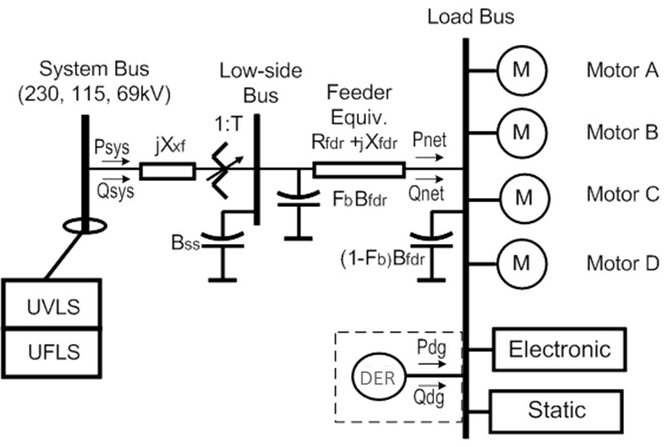
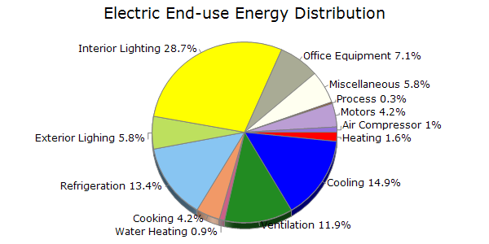
Part 1
Understanding how non-industrial uses of electricity are accounted for in the composite load model

Slide 5
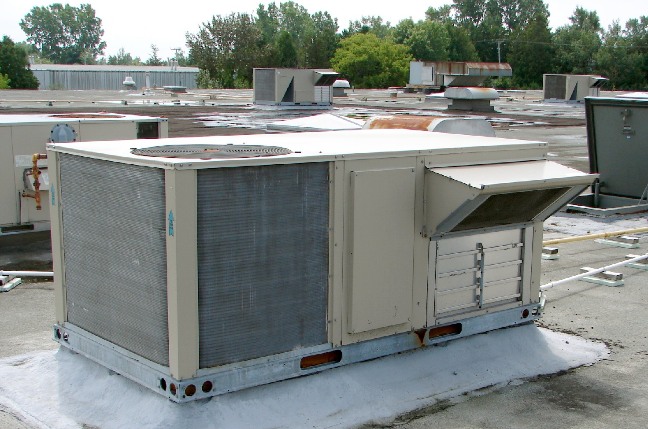
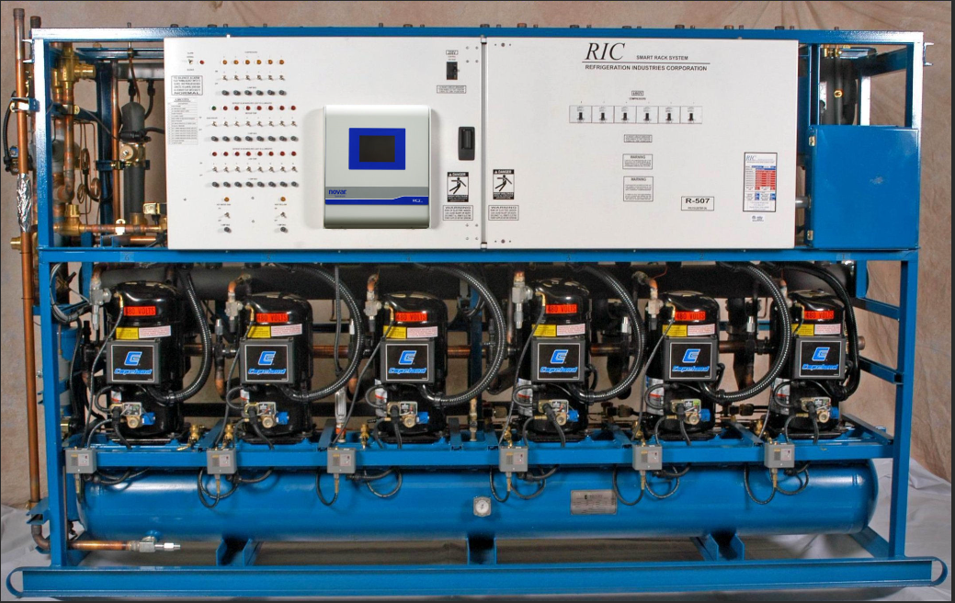
What is Motor A?
Motor A consists of 3-phase direct drive reciprocating and scroll compressors
The most common application of these compressors is package terminal HVAC (heating, ventilating, and air conditioning) units on commercial buildings, but they are also used extensively in commercial refrigeration units
Rooftop HVAC unit and other package units are most popular means for cooling and heating commercial buildings
Three-phase compressor motors (10 to 20HP) represent most of refrigeration load in grocery stores

Slide 6
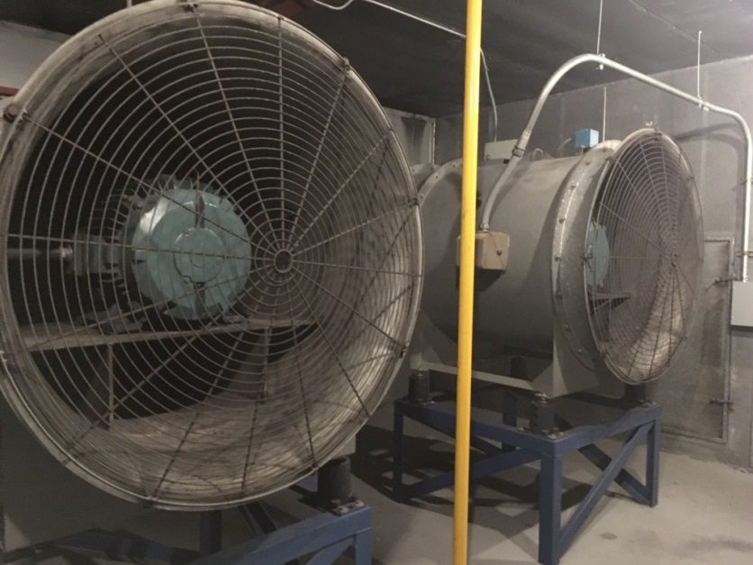
What is Motor B?
Motor B consists of 3-phase direct drive fans
The most common application of these fans is in commercial HVAC system
3-phase fans, 460V, 60 HP each -
Large multi-story commercial buildings
all have centralized HVAC systems

Slide 7
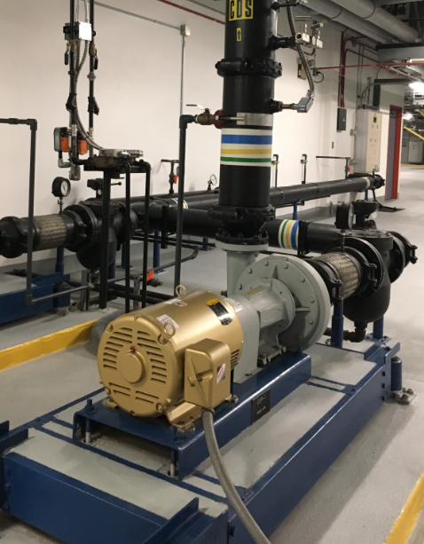
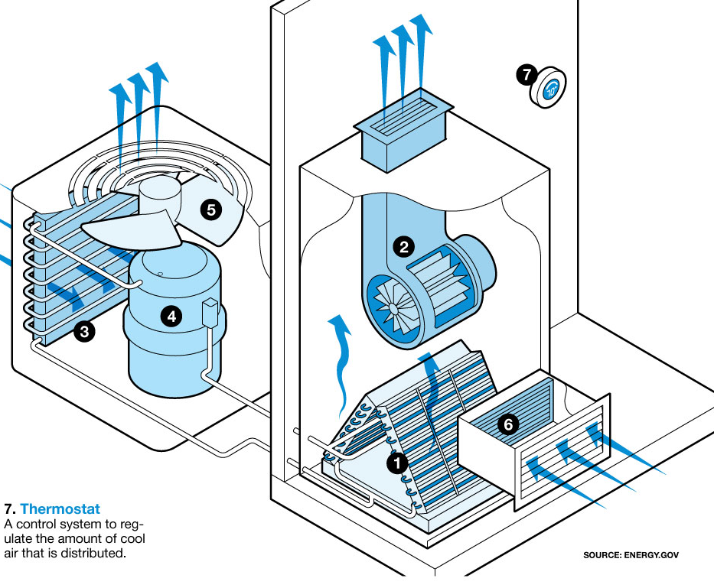
What is Motor C?
Motor C consists mainly of 3-phase direct drive pumps and smaller fans
The most common application of these pumps is in large central HVAC systems and of these smaller fans is in residential HVAC (ventilation)
20 HP “Super-Efficiency” pump motor

Slide 8
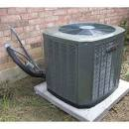
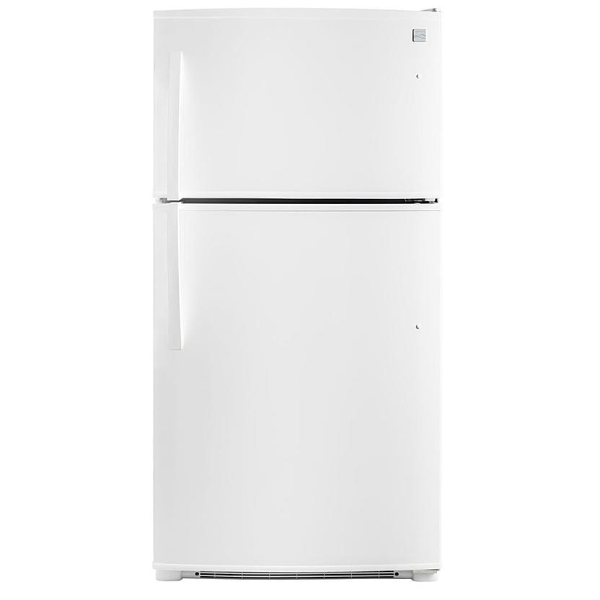
What is Motor D?
Motor D consists mainly of single-phase direct drive induction motor compressors
The most common application of these compressors is in residential central AC units and in residential refrigerator/freezers
Kenmore 61212 21 cu. ft. Energy Star Top-Freezer Fridge - White

Slide 9
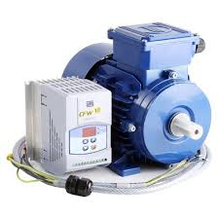
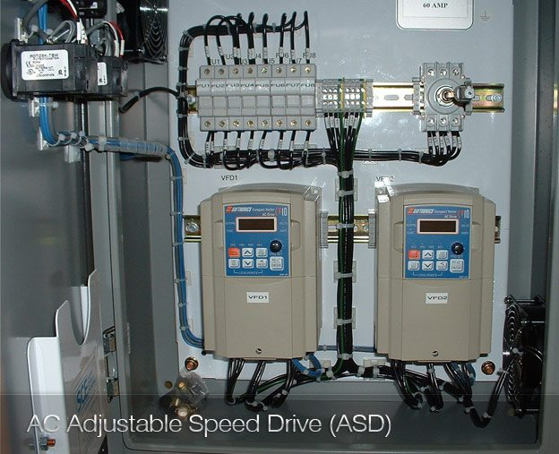
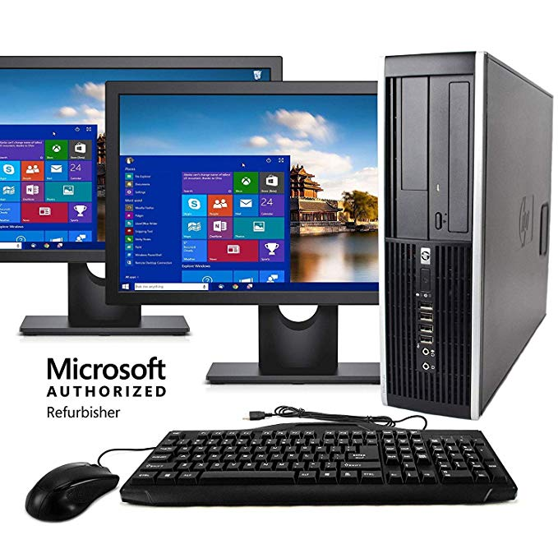
What are Power Electronic loads?
Power electronic loads are loads that are characterized by operation at constant power
The most common applications include adjustable (or variable) speed drives on motors, compressors, and pumps, and all forms electronics-based equipment (computers, monitors, etc.)

Slide 10
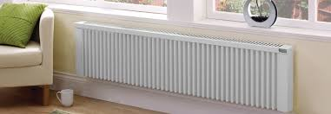

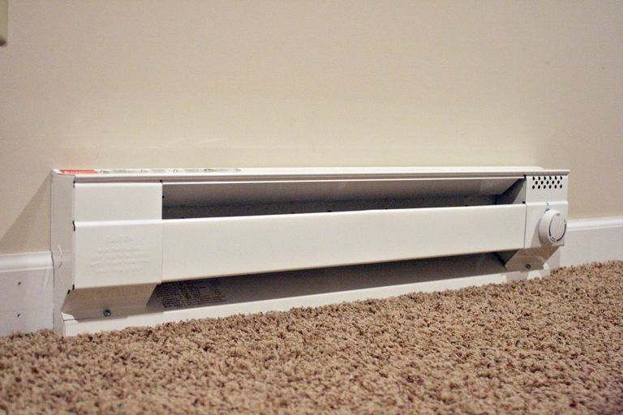

What are Static loads?
Static loads are “catch-all” for all remaining types of loads. Currently, we are distinguishing between those that purely resistive (Stat_P_Res) and those that are constant current (Stat_P_Cur)
The most common purely resistive applications are electric space heating and incandescent lighting and the most common constant current applications are fluorescent lighting

Slide 11
Linking Load Types to End-Uses
Developing models for distribution feeders involves linking information on the end uses of electricity to the 7 load types
Composite Load Type | Electricity End-Use
Motor A | Commercial Cooling Commercial Refrigeration
Motor B | Commercial Ventilation
Motor C | Commercial HVAC (pumping) Residential Ventilation
Motor D | Residential Cooling Residential Refrigeration
Power Electronic | Adjustable speed drives All electronics
Stat_P_Res | Space heating, Water heating, Incandescent lighting
Stat_P_Cur | Fluorescent lighting

Slide 12
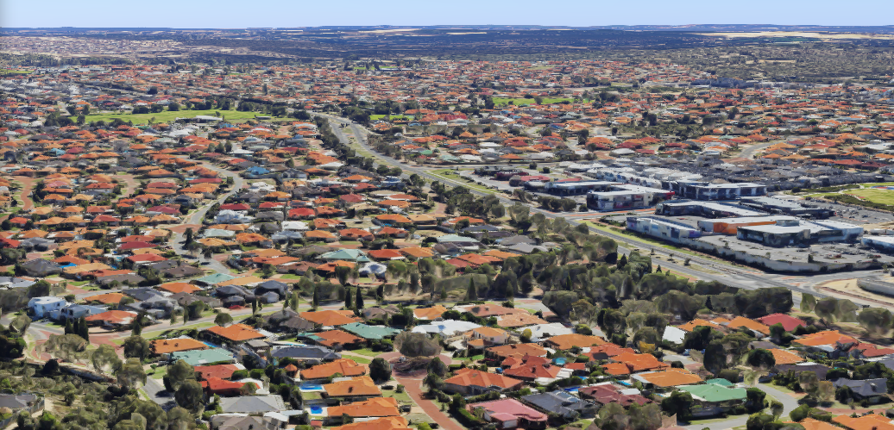

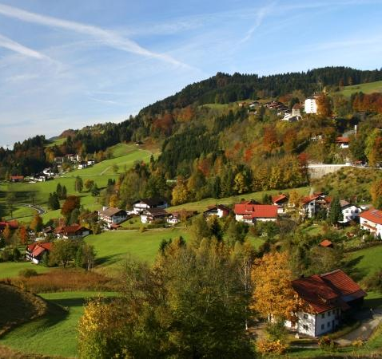
Part II
Developing region- and feeder-specific composite load models
RES - suburban
COM - urban
MIX
RAG - rural

Slide 13
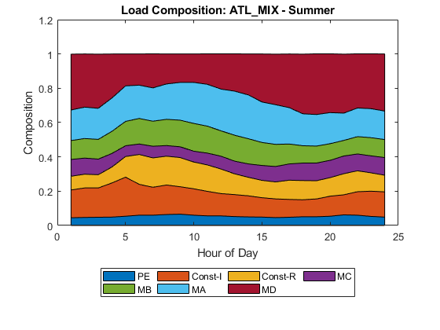
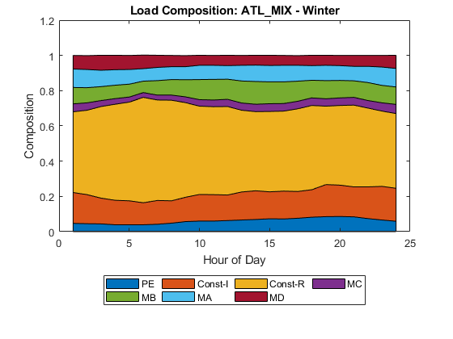
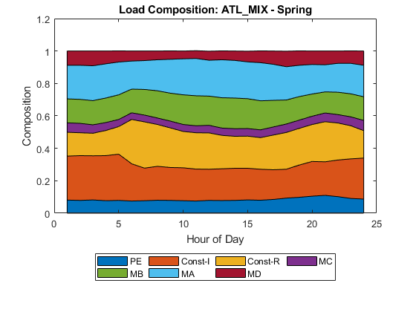
What is the goal of our analysis?
The goal of our analysis is to develop region- and feeder-specific composite load model inputs for 3 study periods: Summer Peak Demand; Winter Peak Demand; and Spring Light Load
4-6 PM
8-10 AM
2-4 AM

Slide 14
Important Opening Perspectives
Our goal is to develop reasonable and credible initial estimates in order to enable industry to begin conducting meaningful reliability studies
We accept that developing load composition information is currently an imperfect science – Measured data are sparse and many assumptions are required to use them (e.g., building types, building populations, electrification, rules of association)
We approach these challenges by being transparent in the assumptions we’ve made and meticulous in the consistent application of our engineering methods
We also gain confidence in our approach by comparing initial findings to the past efforts of others (notably ISO-NE, and FRCC)
There will always be opportunities to improve the analysis – we will be pursuing sensitivity studies, exploring other data sources, and refining our analysis up to the time of the field trials

Slide 15
Overview of Methodology
Step 1. Starting with hourly end-use metered data
Estimate sensitivity of heating and cooling loads to recorded weather
Use region-specific weather to estimate region-specific heating and cooling loads for each of the three reliability planning study days (summer peak, winter peak, spring light load)
Adjust heating and water heating loads based on region-specific information on the extent to which these loads are electric (electrification fractions)
Step 2. Apply rules of association to each building and end-use to develop hourly load shapes for each of the 7 composite load model load types
Step 3. Combine hourly composite model load shapes for various building types to estimate region-specific, feeder models

Slide 16
Methodology – Step 1
The objective of this step is to develop region-specific load shapes for individual building types
Space
Cooling
Space
Cooling
Sensitivity
Space
Cooling
Historical
Weather
Region-Specific
Weather
Hourly Metered Loads for A Single Building Type
(residential, office, retail, lodging, etc.)
Space Heating
Space
Heating
Sensitivity
Region-Specific
Electri-fication
Space Heating
Water Heating,
Cooking
Water Heating,
Cooking
Refrigeration,
Electronics,
Lighting, etc.
Refrigeration, Electronics,
Lighting, etc.
This step in the analysis is repeated for each building type and for each region

Slide 17
Methodology – Step I1
The objective of this step is to map hourly end use loads for individual building types to the 7 composite load model types
Motor A
Space
Cooling
Motor B
Space Heating
Motor C
Rules of Association
Motor D
Water Heating,
Cooking
Power Electronic
Refrigeration,Electronics,
Lighting, etc.
Stat_P_Res
Stat_P_Cur
This step in the analysis is repeated separately for each building type

Slide 18
Methodology – Step 11I
Each distribution feeder model is a composite of several different types of buildings or facilities
Building Type | RES Suburban | COM Urban | MIX | RUR Rural
Residential | 66% |  | 43% | 43%
Office |  | 61% | 14%
Retail | 7% | 11% | 10% | 9%
Grocery | 6% | 4% | 6% | 7%
Restaurant | 13% | 15% | 17% | 13%
Lodging |  | 9% | 5%
School | 5% |  |  | 4%
Warehouse | 1% |  | 1% | 2%
Industrial | 2% |  | 3% | 7%
Pumping |  |  |  | 14%
Percentages are based on relative contributions to summer peak demand

Slide 19
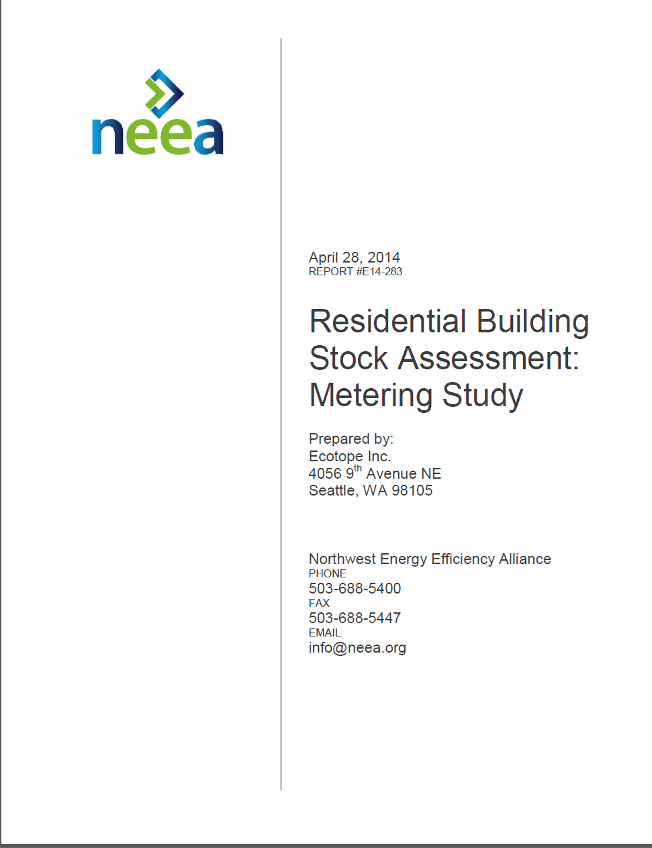
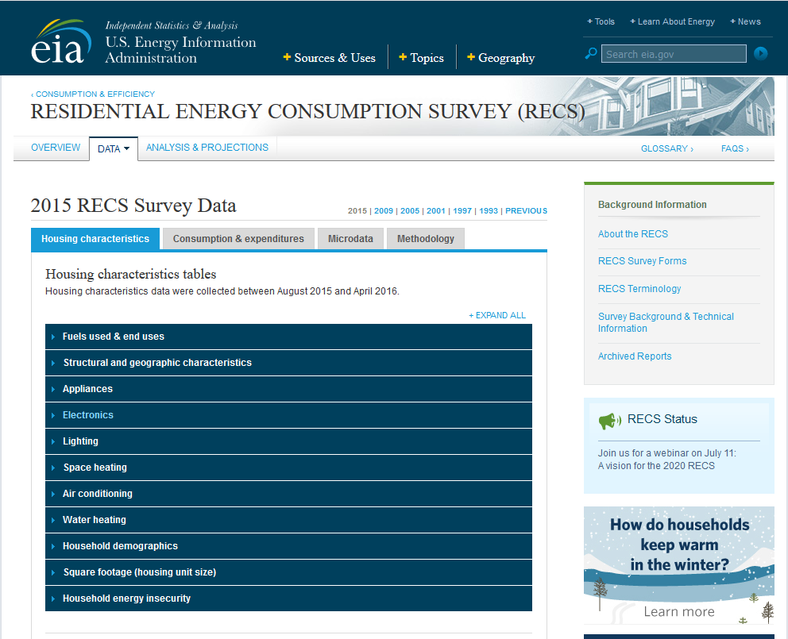
Sources of measured data - Residential
Load shapes
Residential Building Stock Assessment (RBSA)
End-use metering of ~100 residences in the Pacific Northwest (2010-11)
https://neea.org/resources/2011-rbsa-metering-study
Space- and water-heating electrification
U.S. Energy Information Agency Residential Energy Consumption Survey (RECS)
~5600 household surveys conducted in 2015
https://www.eia.gov/consumption/residential/index.php
Information provided on electrification in Canadian electrification was provided by MRO and NPCC

Slide 20
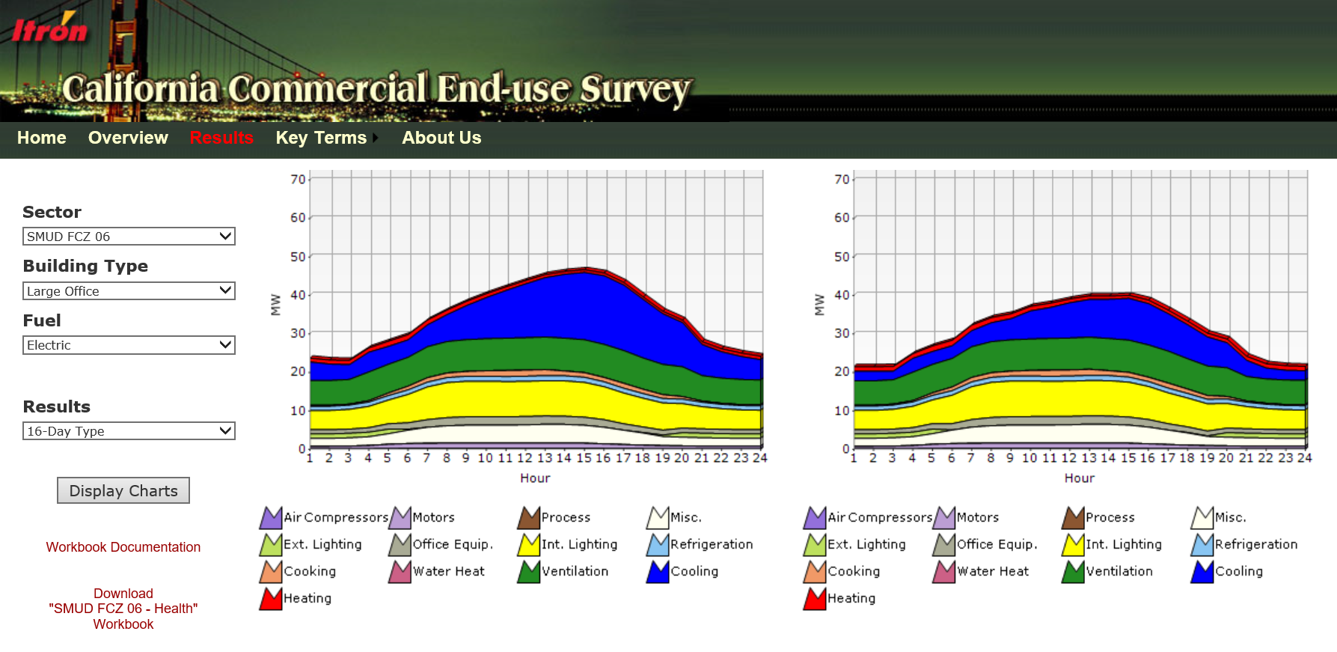
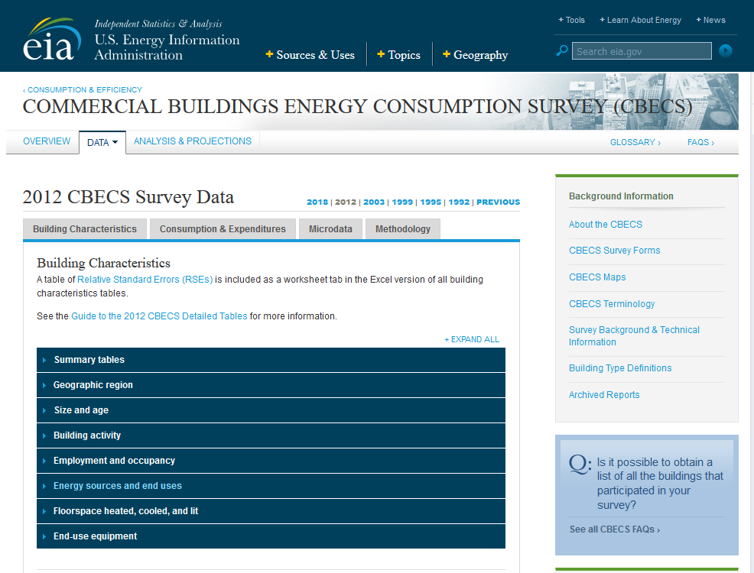
Sources of measured data - Commercial
Load shapes
California Commercial End-Use Survey (CEUS)
Survey-based simulations, calibrated to whole building metered data to develop end-use load shapes for 2800 commercial buildings in California (2004-5)
http://capabilities.itron.com/CeusWeb/ChartsSF/Default2.aspx
Space- and water-heating electrification
U.S. Energy Information Agency Commercial Building Energy Consumption Survey (RECS)
6,700 building interviews (2012)
https://www.eia.gov/consumption/residential/index.php
Information provided on electrification in Canadian electrification was provided by MRO and NPCC

Slide 21
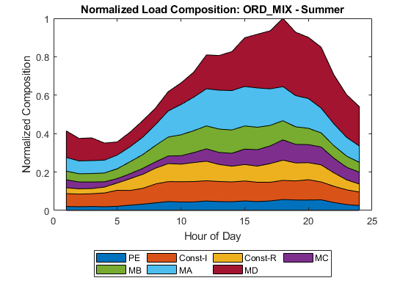
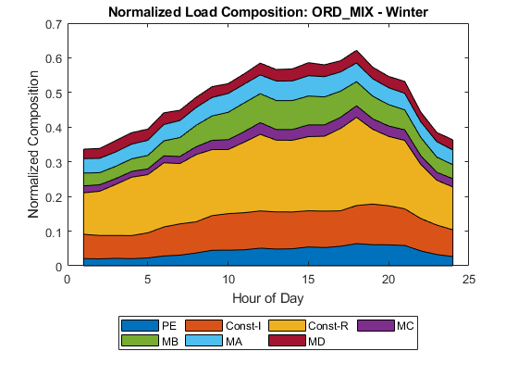
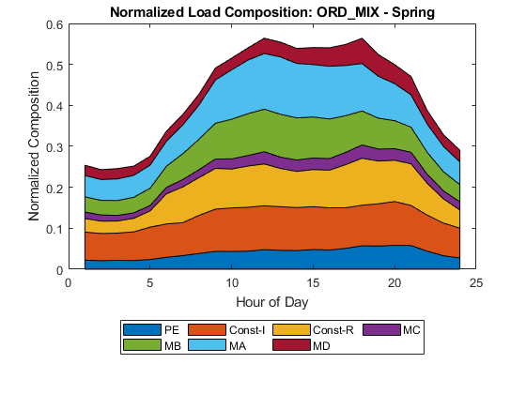
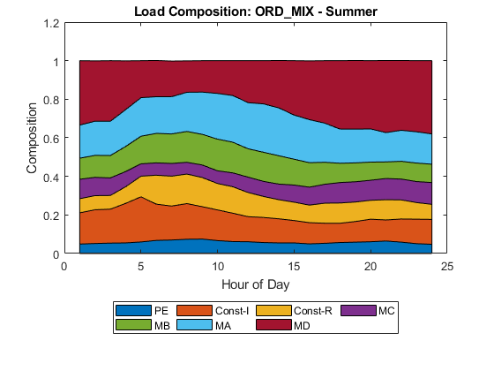
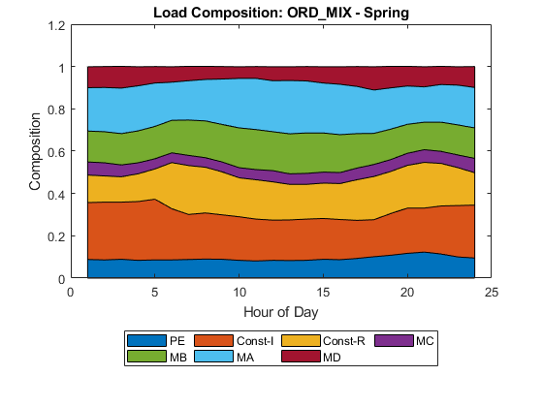
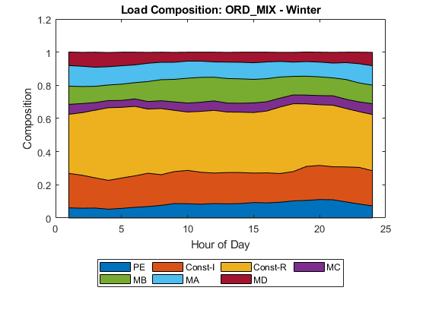
Format of our results
Summer Peak Day Winter Peak Day Spring Light Load Day

Slide 22
Initial Comparisons to Prior Estimates I
DOE sponsored development of composite load model estimates for ISO-New England in 2013

Slide 23
Initial Comparisons to Prior Estimates II
FRCC has also developed composite load model estimates

Slide 24
Next Steps
We have developed an initial set of feeder models for every NERC region
We are currently comparing our initial models with other sources – next up, comparisons with EPRI-developed models
We plan to continue to refine our models in preparation for the field trial starting this fall

Slide 25
Summary and Transition
This talk has:
Provided background and insight into the end-uses represented in the composite load model (Part 1)
Described, at a high-level, the data, methods, and approaches we used to prepare composite load models for non-industrial feeders
Presented initial comparisons of our analysis to prior efforts
The next talk will:
Provide a more detailed description one of the two approaches used to develop models for non-industrial feeders for NERC LMTF

